Slide 1
Interface Inventory
More info about interface inventories

Slide 2
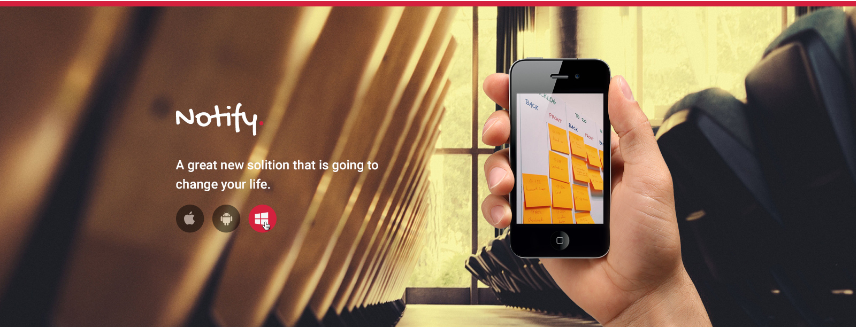
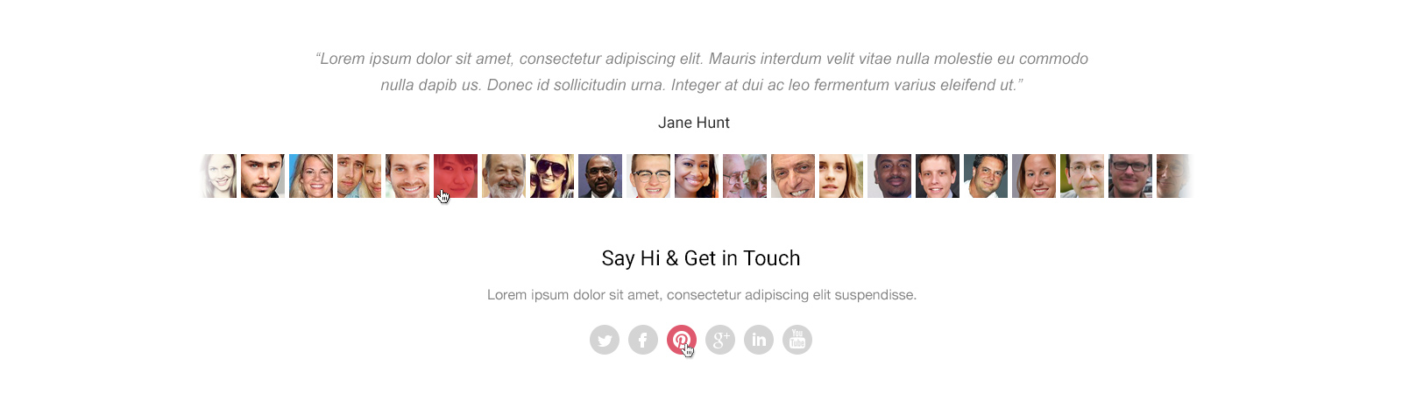
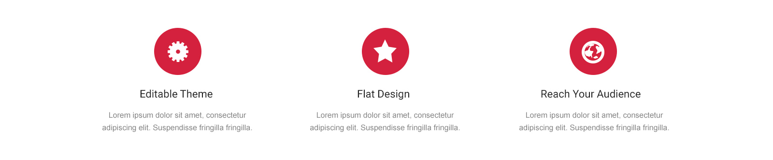
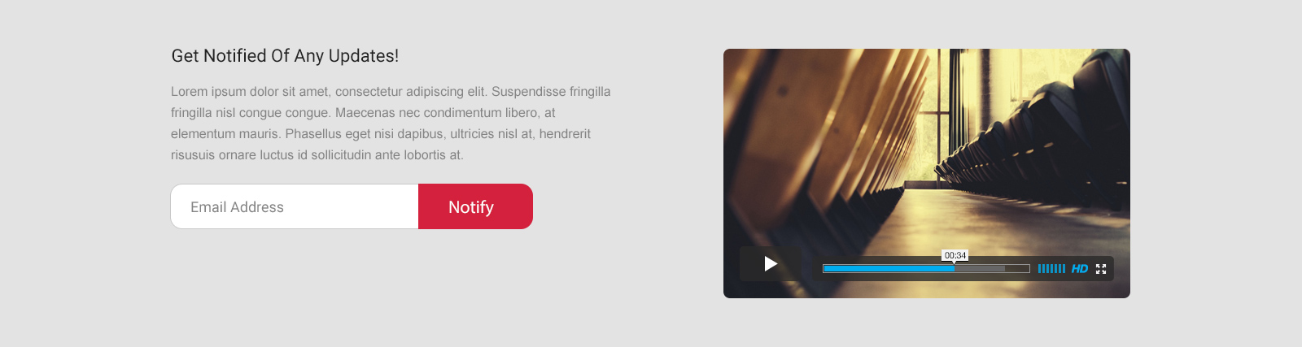
Global
Headers, footers, and other global elements

Slide 3
Navigation
Primary navigation, footer nav, pagination, breadcrumbs, etc
.footer

Slide 4



Image Types
Logos, heros, avatars, thumbnails, etc
.logo
.thumbnail

Slide 5












Icons
Magnifying glasses, social icons, spinners, favicons, hamburgers, arrows, etc
.flaticon
.icon-large

Slide 6

Forms
Inputs, textareas, select menus, checkboxes, radios, and more
.form

Slide 7

Buttons
Big, small, primary, secondary, progress, etc
.button

Slide 8
Interactive Components
Accordions, tabs, carousels, anything with moving parts
.carousel

Slide 9
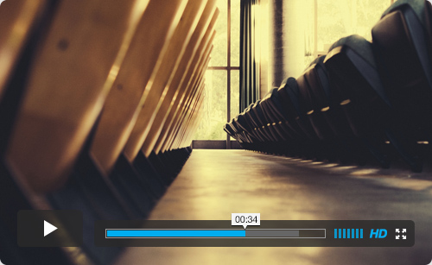
Media
Video players, audio players, etc
.vimeo

Slide 10
Messaging
Alerts, success, errors, warnings, errors, validation

Slide 11

Headings
h1, h2, h3, h4, h5, h6 and variations of typographic headings
.heading-feature
.heading-section

Slide 12
Lists
Unordered, ordered, definition lists, bulleted, lined, etc

Slide 13
3rd Party
Widgets, iframes, stock tickers, social buttons, anything that isn’t hosted on your domain

Slide 14
Advertising
Ad units

Slide 15
“Blocks”
Combination of images, headlines, excerpts

Slide 16
Animation
Capture videos of interface animation

Slide 17







Color
Unique colors represented in the UI

